Slide 1
Modular Programming(3-dars)
Davronbek Malikov

Slide 2


Bugun
Project 1 + Modular Structure(yakuniy xolat)
Takrorlash
Folder Structure review
Git-Bash “ichkari”
Virtual Environment
Virtual Environment yaratish
Data Extraction
Vazifa

Slide 3
Project 1 + Modular Structure(yakuniy xolat): Submission

Slide 4
Takrorlash

Slide 5

Takrorlash
Savol Javob + Project 1 xolati
Git Review + Install
Git commands
Git commands amaliy
Project structure(modular)
Git->Project->Github
Project xolati

Slide 6
Folder Structure review

Slide 7
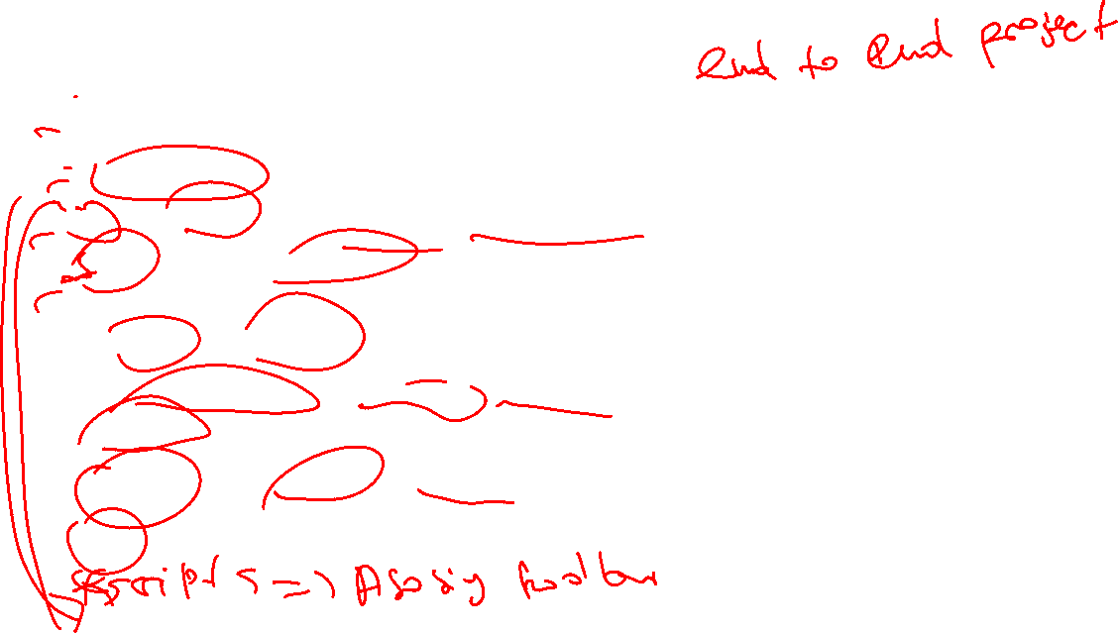
Folder Structure review
Data– raw materials(raw, preprocessed)
Notebooks—training room(.ipynbfilelar)
Src---mator(asosiy codelar, classeslar turadi)
Tests—Quality checking(bo’limlar, class, funcksiyalarni ishlayotganlik darajasini tekshiring)
Models—Warehouse(Trained models)
Requirements.txt—Tool list(Dependencies)
Readme---Instruction(Project overview)
.gitignore---Qo’riqchi(Keraksiz filelarga to’siq qo’yadi)
Logs---cctv(monitoring room)(training.log,erro.log,metrics.csv)

Slide 8

Git-Bash ichkari

Slide 9



Git-Bash ichkari
Standalone Git Bash
Yaxshi agar turli xil repositorylar ochiq bolsa va kattaroq ekran kerak bolsa
Yomon agar sizga sahifadan sahifaag o’tish yoqmasa
Git bash in Vs code
Yaxshi-----kodlarni va ozgarishlarni yaxshiroq korib ketasiz
Yomon--- kichikroq ekran

Slide 10

Virtual Environment

Slide 11

Virtual Environment
Pythonni ichidagi alohida workspace bu --- Virtual Environment
Pythondan foydalangan xolda turli xil project qilishimiz mumkin lekin:
Turli xil ziddiyatlar(turli xil project turli xil kutubxona versialarini talab qiladi)
Team Projectlarda xam boshqalarni kopyuteri bn ziddiyatga borishi
Modular Programmingda: Xar bir project o’zini alohida olamine talab qiladi
Analogy: Mamlakat ichidagi avtanom davlat

Slide 12

Virtual Environment
Notes:
Python>=3.6
(3.3 ok , 3.6 recommended)->modern library
Language features(f-strings, 3.6 versiya yoki undan keyin ishlaydi)

Slide 13
Virtual Environment yaratish

Slide 14

Virtual Environment yaratish
Install Python(>=3.6)
Create
Activate
Install packages
List
Save(requirements.txt)
Pip freeze
Deactivate

Slide 15

Data Extraction

Slide 16

Data Extraction
Malumotlarni turli xil joylardan to’plash jarayoni
Boshqalarni to’plagan datasi bn emas o’zimizni datamiz bilan ishlash

Slide 17


Data Extraction: Etiket
Eng avvalo ruxsat so’rash kerak
Robots.txt(https://www.transfermarkt.com/robots.txt. )
Maqolada foydalanmoqchi bolsangiz cite berishingiz kerak

Slide 18

Data Extraction:+/-
+:
Boshqalarda bo’lmagan datasetga egalik
Boshqalar qilmagan model yarata olishlik
-:
Vaqt ko’p ketadi

Slide 19

Data Extraction: How?
Coding
Static HTML
Dynamic HTML
No Coding(Octaparse)

Slide 20

Vazifa
Report yozing+ Upload(pdf)
Project 2 ni boshlang(Structure,Data Preprocessing)
Og’zaki savol javobga tayyorlaning

